Slide 1
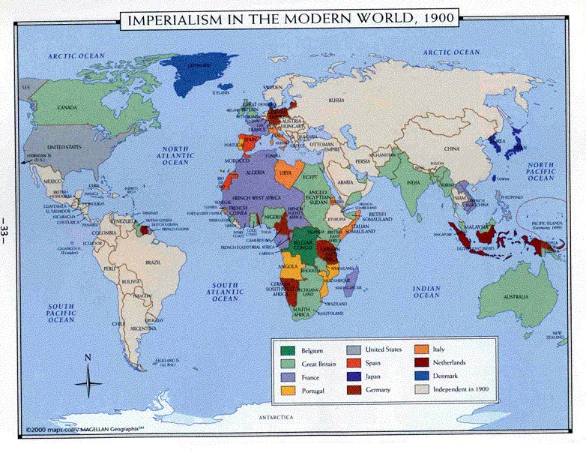
African Imperialism & 19th & 20th Century “Informal” Imperialism: Africa, Asia, and Latin America

Slide 2
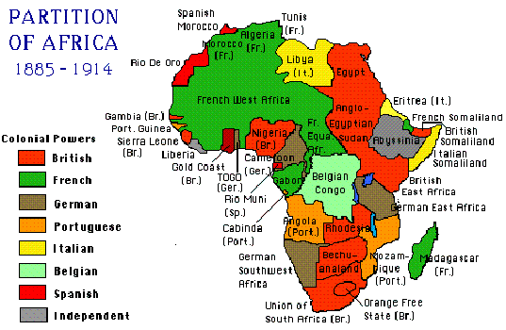
Africa before Imperialism
Before the arrival of European imperialists, boundaries in Africa were loosely defined.
They reflected territories inhabited and controlled by different ethnic and tribal groups.

Slide 3
The Scramble for Africa (1870-1890)
By 1870, Europeans controlled very little actual territory in Africa
France had acquired Algeria, in the Northwest, in the 1830’s
Britain controlled South Africa
Communities in the interior of sub-Saharan Africa still remained isolated and very diverse
This changed dramatically between 1870 and 1890, as European powers engaged in a “Scramble for Africa”

Slide 4
Northeast Africa: Suez Canal
In the early 1880’s, a local revolt threatened European use of the Suez Canal.
The Suez Canal was completed by French engineers in 1869 and provided the shortest route from Europe to East Africa, India, and East Asia.
It became the lifeline between Britain and its colony in India
The British quickly moved to put down the revolt and take over Egypt.
Next, British troops took over the Sudan

Slide 5
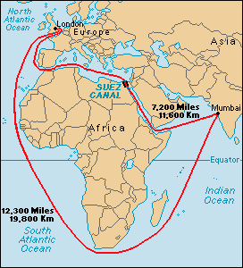

Slide 6
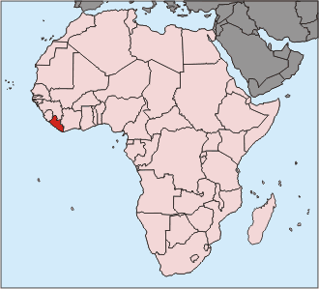
European Powers Jump In
Other powers—France, Italy, Germany, & Belgium—eyed British actions jealously.
They wanted parts of Africa for themselves.
Diamonds, gold and other valuable resources were also discovered in Africa in the late 19th century.
In 1884, at the Berlin Conference, Bismarck and other European leaders divide up the remaining parts of Africa.
By 1890, only Ethiopia and Liberia remained independent

Slide 7
Major Imperial Powers
The major European powers with colonies in Africa were Great Britain, France, Germany, Belgium, Portugal, and Italy
The French acquired much of Central Africa and Northwest Africa above the Sahara.
King Leopold II of Belgium ruled the Congo in the center of Africa as his private estate
He treated the natives harshly, killing millions to increase production on his rubber plantations.
The British established colonies in West Africa and along almost the whole length of East Africa from Egypt to South Africa
Cecil Rhodes, a leading British imperialist, planned to build a railway down the eastern side of Africa from Cairo in Egypt to Capetown, South Africa.
Germany took Tanganyika, Cameroon, Togo, and Southwest Africa

Slide 8
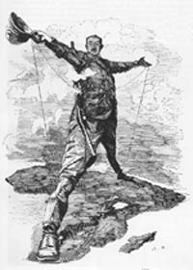
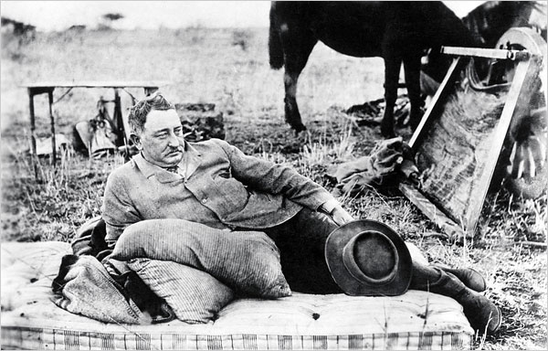

Slide 9
Cecil Rhodes Quotes
“Remember that you are an Englishman, and have consequently won first prize in the lottery of life.”
“We must find new lands from which we can easily obtain raw materials and at the same time exploit the cheap slave labor that is available from the natives of the colonies. The colonies would also provide a dumping ground for the surplus goods produced in our factories.”

Slide 10
Legacy of Imperialism in Africa
European powers paid no attention at all to existing tribal boundaries.
Wherever possible, they established mining operations or cultivated cash crops to be sold to Europe.
Native Africans were used as a cheap workforce.
Europeans also introduced advanced Western technology and ideas
Thus, Imperialism had both positive and negative effects on Africa

Slide 11
Positive & Negative Effects of Imperialism on Africa
Positive
Negative
European medicine and improved nutrition increased the life-span of Africans-Population
Europeans helped modernize and industrialize Africa
A small minority of African received improved education and greater economic opportunities
Led to an erosion of traditional African values and destroyed many existing social relationships
African peoples were treated as inferiors and forced to work long hours, in bad conditions, for low pay
Europeans ignored tribal, ethnic, and cultural boundaries which has led to continuing tribal conflicts in many African nations

Slide 12
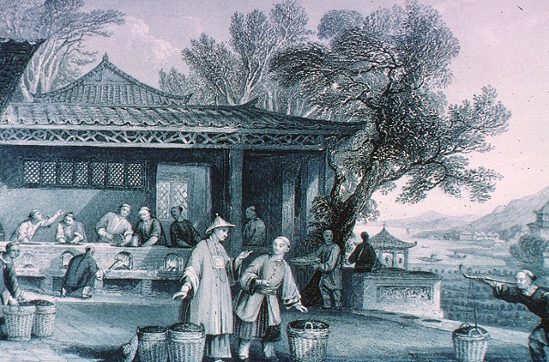
“Informal” Imperialism in Asia
“Informal” imperialism- in areas where direct rule was not established, European powers often dominated an area’s economy

Slide 13
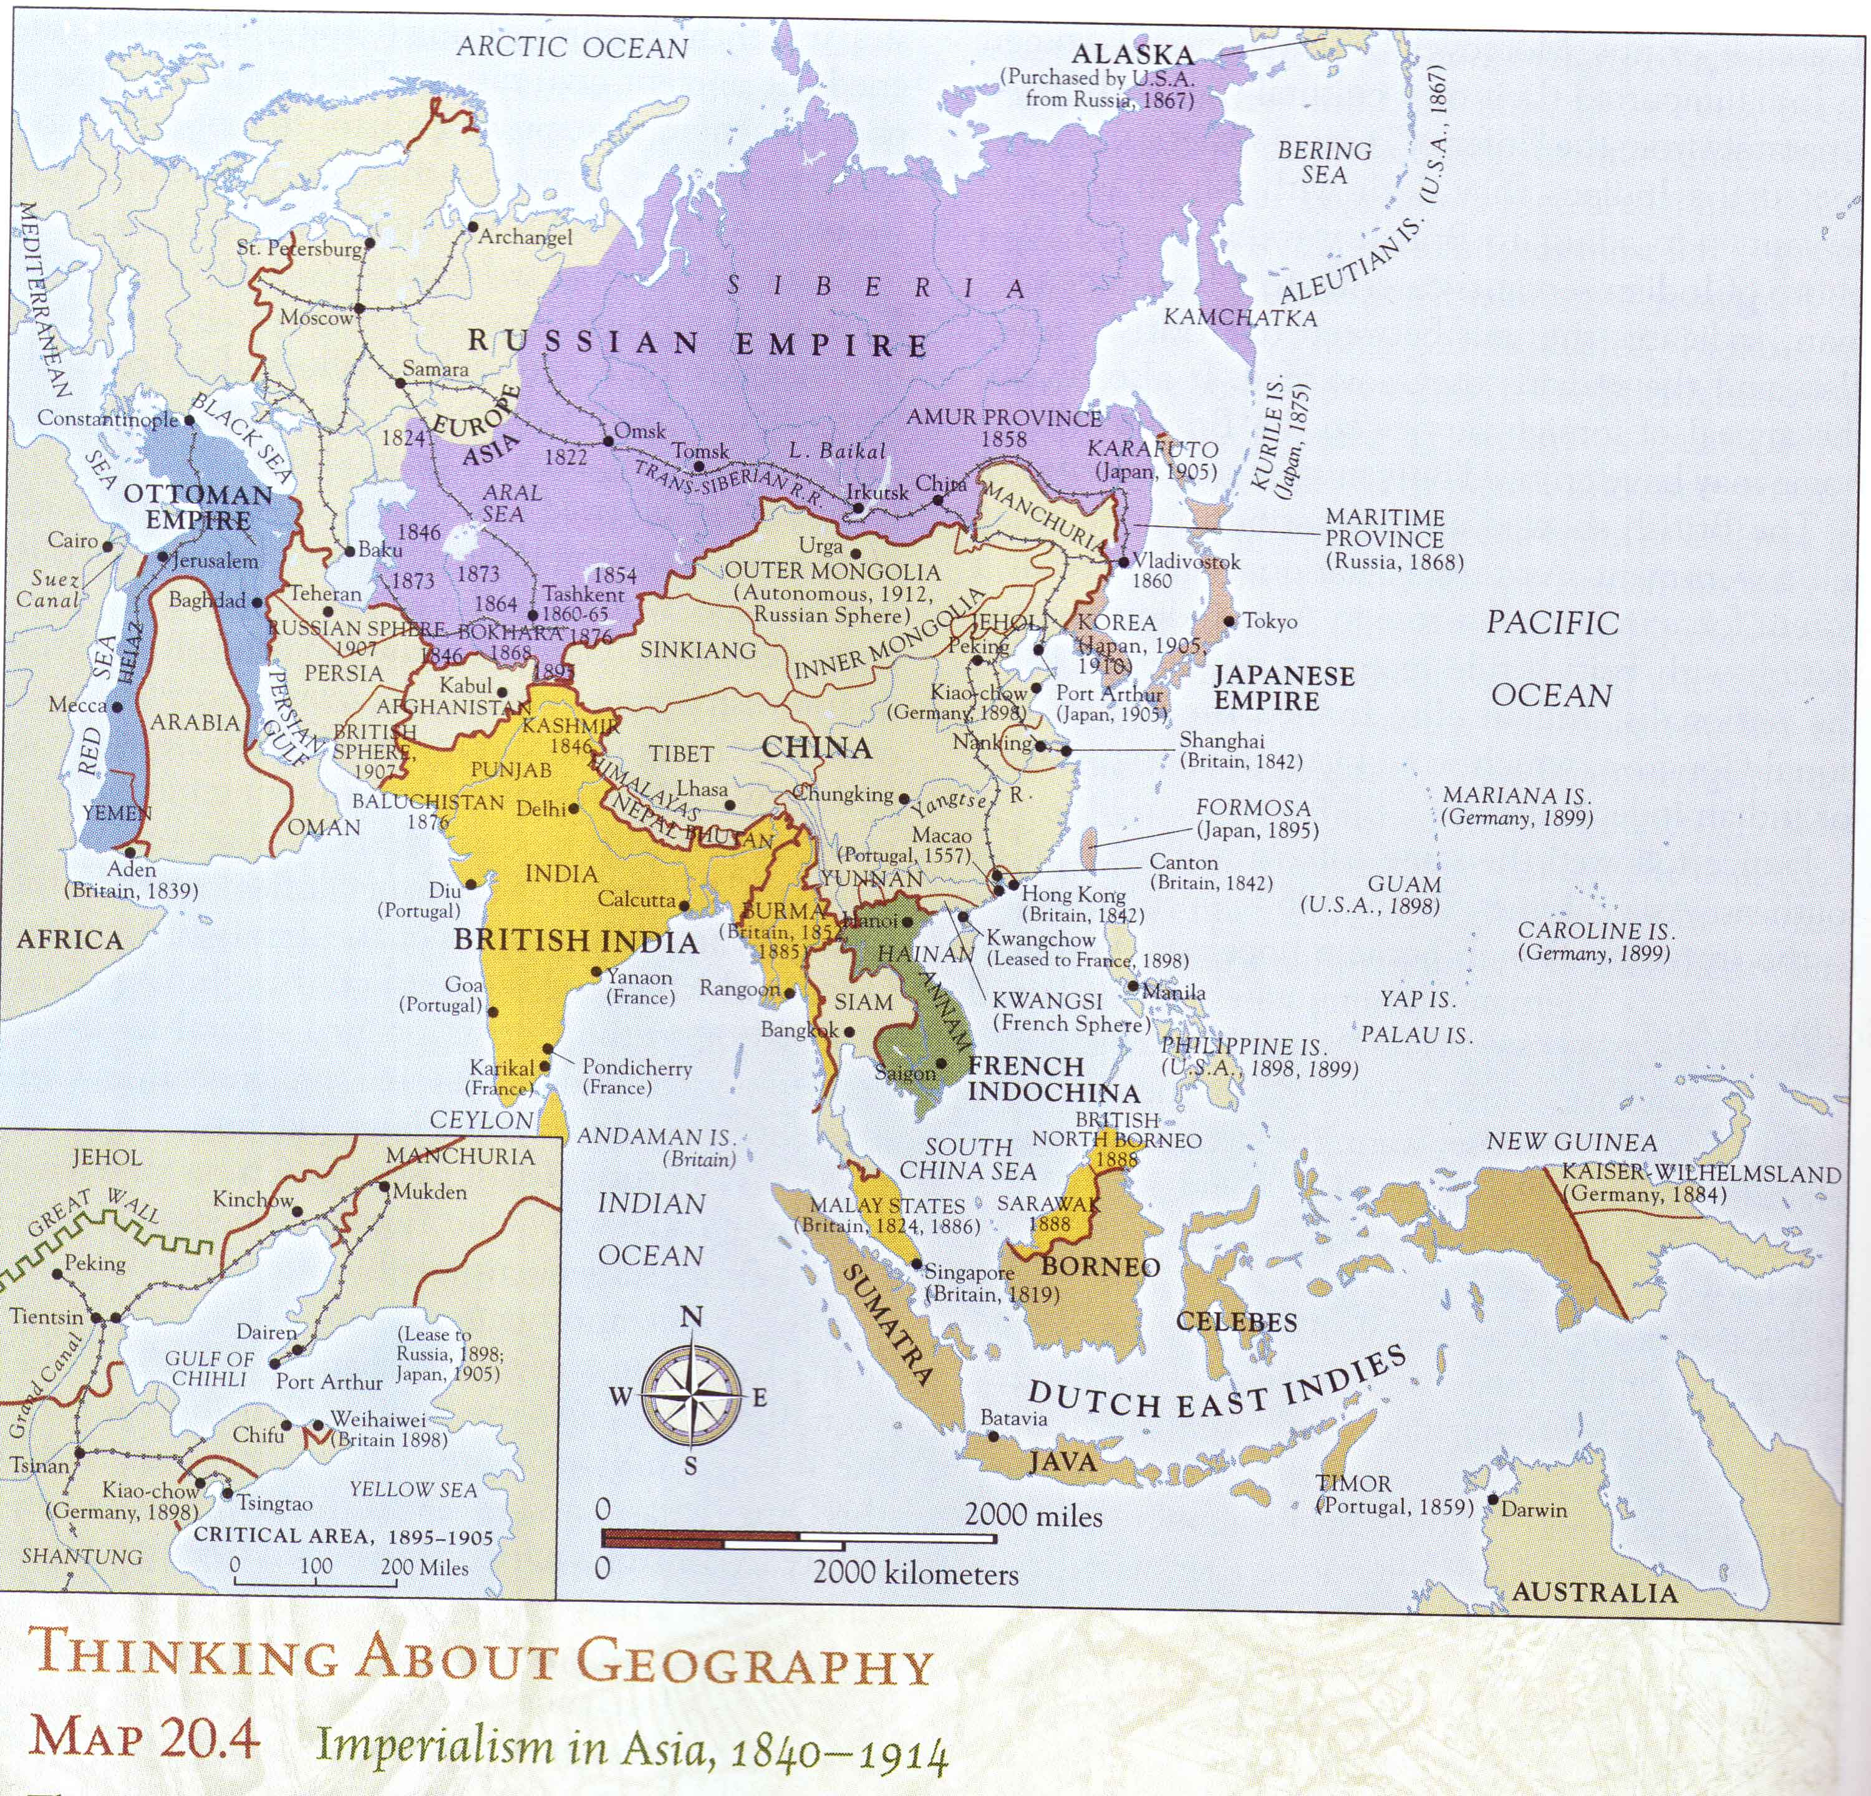

Slide 14
China
For thousands of years China had been united under its powerful emperors
However, China had remained isolated from the world and by the 1830’s, it lacked the military technology it needed to oppose Western Imperialism
Western nations showed an interest in China because its huge population offered a potential market for European manufactured goods.
It also possessed valuable raw materials and produced local goods sought by Europeans.
In China, European powers developed a system of “informal” imperialism

Slide 15
The Opium Wars (1839-1842)
In the 1800’s, Great Britain began selling opium in China to obtain money to buy tea.
The government of China tried to stop this practice by sentencing Chinese opium dealers to death.
The British reacted by declaring war.
With their superior gunboats, the British were able to fire on Chinese coastal towns.
China was defeated and was forced to continue the sale of opium.

Slide 16
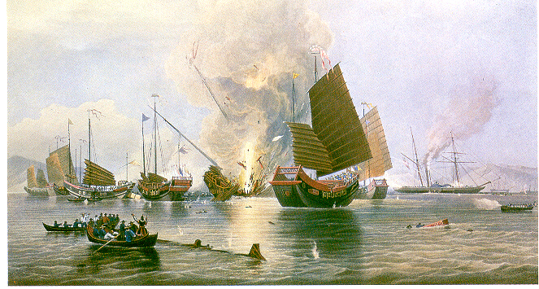

Slide 17
Opium & China
Opium damaged the Chinese economy, and created chaos and political instability in China
China was also forced to open several “treaty ports, “ giving the British new trading privileges
The British established several “Spheres of influence”—areas of China under their exclusive economic control
A flood of cheap British textiles hurt Chinese industry
Other European countries soon followed the British example and demanded their own spheres of influence

Slide 18
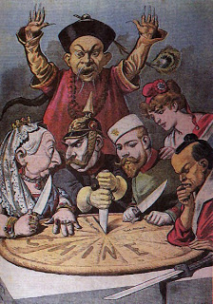

Slide 19
China & the West
Increasing European interference was extremely unpopular in China and weakened the prestige of the ruling Manchu Dynasty
The defeat of the Chinese army in the Opium Wars proved to the Chinese that they were no longer the “Heavenly Middle Kingdom.”
Manchu rulers faced a series of major revolts.
Millions of Chinese were killed when China’s rulers put down the Taiping Rebellion (1850-1864) with European help

Slide 20
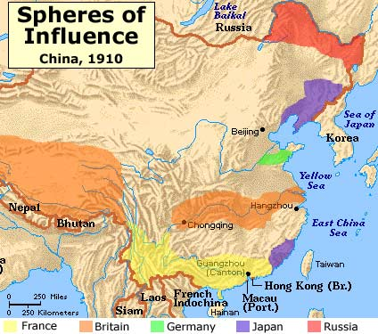

Slide 21
America’s “Open Door” Policy & the Boxer Rebellion
Fearing it would be shut out of China’s profitable trade, the United States proposed Equal trading rights for all nations in China in 1899
In 1899, a Chinese group known as the “Boxers” rebelled against the spread of foreign influence in China
Hundreds of foreigners living in Chinese cities were killed during the riots led by the Boxers
An international force, composed of troops from foreign powers, finally crushed the Boxer rebellion in 1900

Slide 22
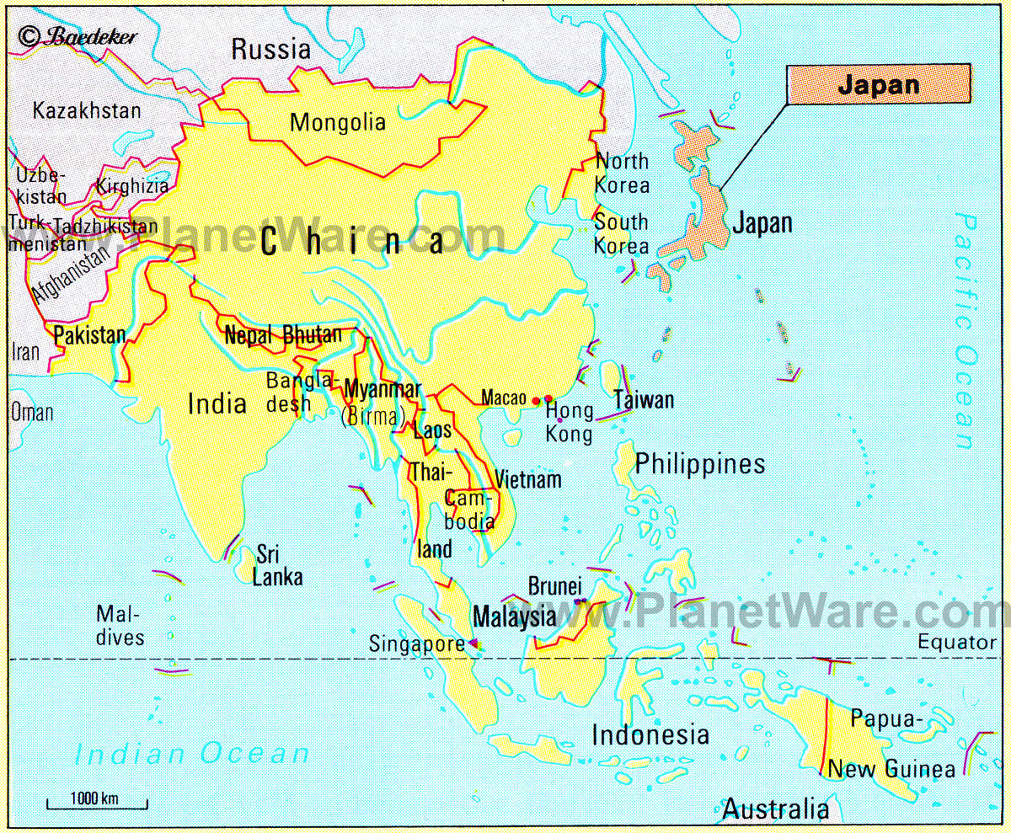

Slide 23
The Opening of Japan
In 1853, the United States government sent a naval squadron commanded by Commodore Matthew Perry to Japan.
In addition to requesting better treatment for shipwrecked sailors, the American sought to develop new markets and establish a port where their ships to China could stop to obtain supplies.
Fearing a fate similar to China’s, Japanese leaders opened their doors to American trade.
Within a few years, the British, Russian, and Dutch negotiated similarly favorable treaties

Slide 24
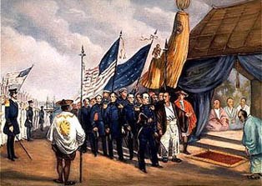

Slide 25
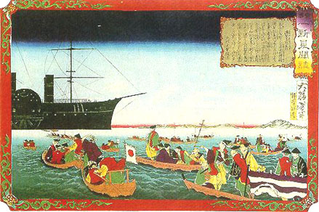

Slide 26
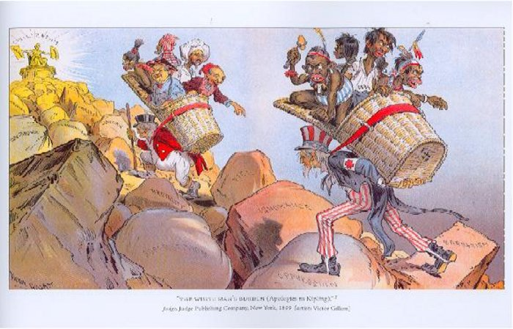

Slide 27
The Meiji Restoration (1868-1912)
The Japanese samurai and daimyos criticized the Shogun (Japan’s ruler) for opening Japan to the West.
Under this criticism the Shogunate collapsed and the emperor, who had been a powerless figure head for over a thousand years, was restored to power
Emperor Meiji, was convinced that Japan had to adopt Western ways if it was to escape future domination by the Western powers
He sent scholars to other countries to learn advanced technologies and foreign customs, and received visits from foreign ministers.
Steamboats and railroads were built and a new constitution was decreed.
Japan became the first non-Western country to successfully copy and adapt Western ways

Slide 28
