Slide 1
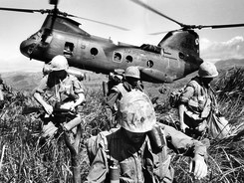
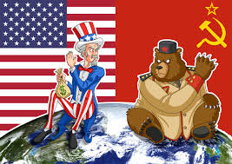
The Cold War at its Height

Slide 2
The Nuclear Arms Race
In 1949, the soviet Union exploded its first atomic bomb.
Soon both the United States and Soviet Union also developed far more destructive hydrogen bombs and the missiles to deliver them.
A space race also developed and the Soviet Union took an early lead when they launched Sputnik, a satellite, into outer space in 1957.
Both Superpowers realized these weapons were too powerful and could not be used without terrible consequences
They stockpiled nuclear weapons to serve as deterrents, preventing either Superpower from attacking the other

Slide 3
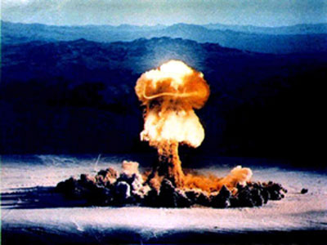
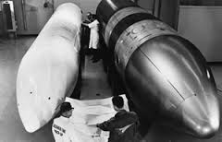
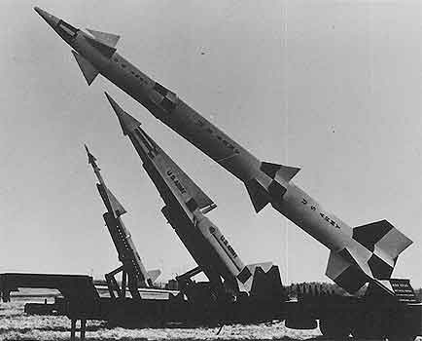

Slide 4
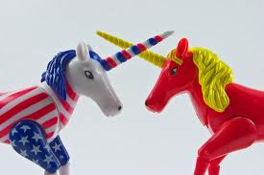
Competition leads to Conflict
The USA and the USSR both were soon locked in a new “Balance of Terror,” which forced them to find other channels for competition.
They soon became involved in a number of regional conflicts, some of which led to warfare on a limited scale.

Slide 5
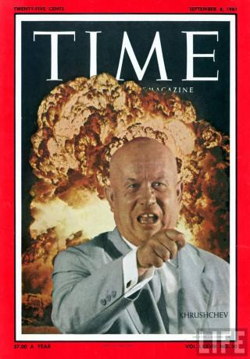
Nikita Khrushchev takes over USSR
In 1953, Stalin died
Nikita Khrushchev emerged as the next leader of the Soviet Union.
Khrushchev condemned Stalin’s atrocities, freed many political prisoners, and attempted to introduce changes into the Soviet Union.
Khrushchev’s condemnation of Stalinism triggered unrest in Eastern Europe, where local populations were unhappy with Communist rule.

Slide 6
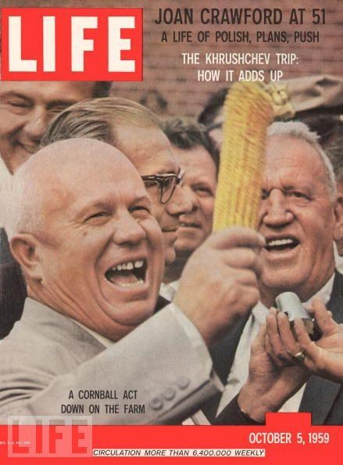
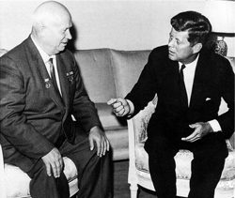

Slide 7
Problems & Protests in Eastern Europe: Poland, Hungary, & Czechoslovakia
Poland
In 1956, workers went on strike demanding greater freedom. Khrushchev agreed to let Polish reformers handle their own affairs so long as Poland remained Communist and continued to be loyal members of the Warsaw Pact
Hungary
Students launched demonstrations in favor of reform. Unlike Poland, Hungarian leaders threatened to leave the Warsaw pact. Soviet troops were sent into Hungary in 1956 and brutally crushed the reform government
Czechoslovakia
In 1968, after Czech leaders proclaimed a more liberal policy called “Communism with a human face,” the Soviets sent tanks into Prague.
Czech leaders were replaced by hardline Communists

Slide 8
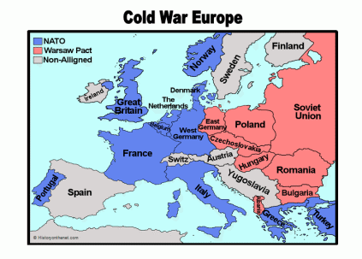

Slide 9
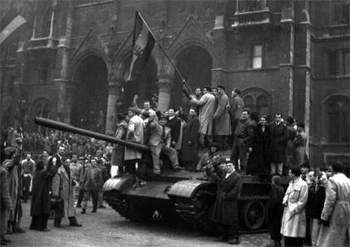

Slide 10
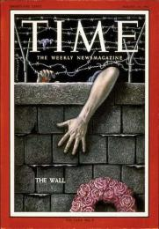
Problems & Protests in Eastern Europe: East Berlin & The Berlin Wall
The split between East & West Berlin was a beacon to the prosperity of capitalism and the struggles of communism
Many East Germans fled to West Berlin and many who stayed in the East worked shopped and dated in the West
In 1961, Khrushchev had a wall built to seal off East and West Berlin, and barriers went up along the border of East and West Germany
This separated friends and families for many years
The Berlin Wall would see many reinforcements over the years and would serve as a strong symbol of the Cold War
There are many examples of East Berliners taking extreme measures to make it to West Berlin

Slide 11
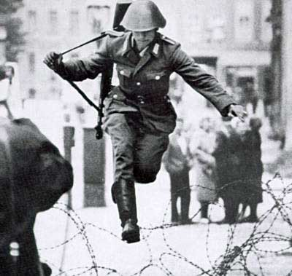
Conrad Schumann
http://www.youtube.com/watch?v=rMAXqV23gHQ

Slide 12
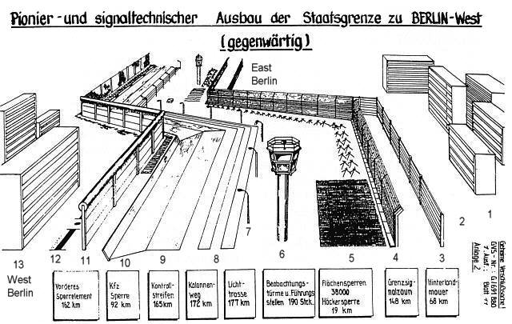
http://www.youtube.com/watch?v=-9VKVt4yuhI

Slide 13
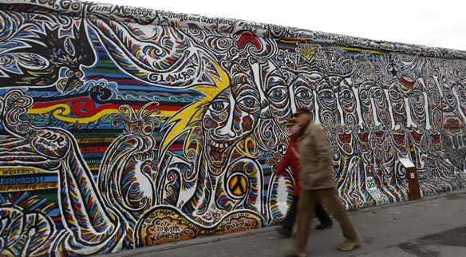
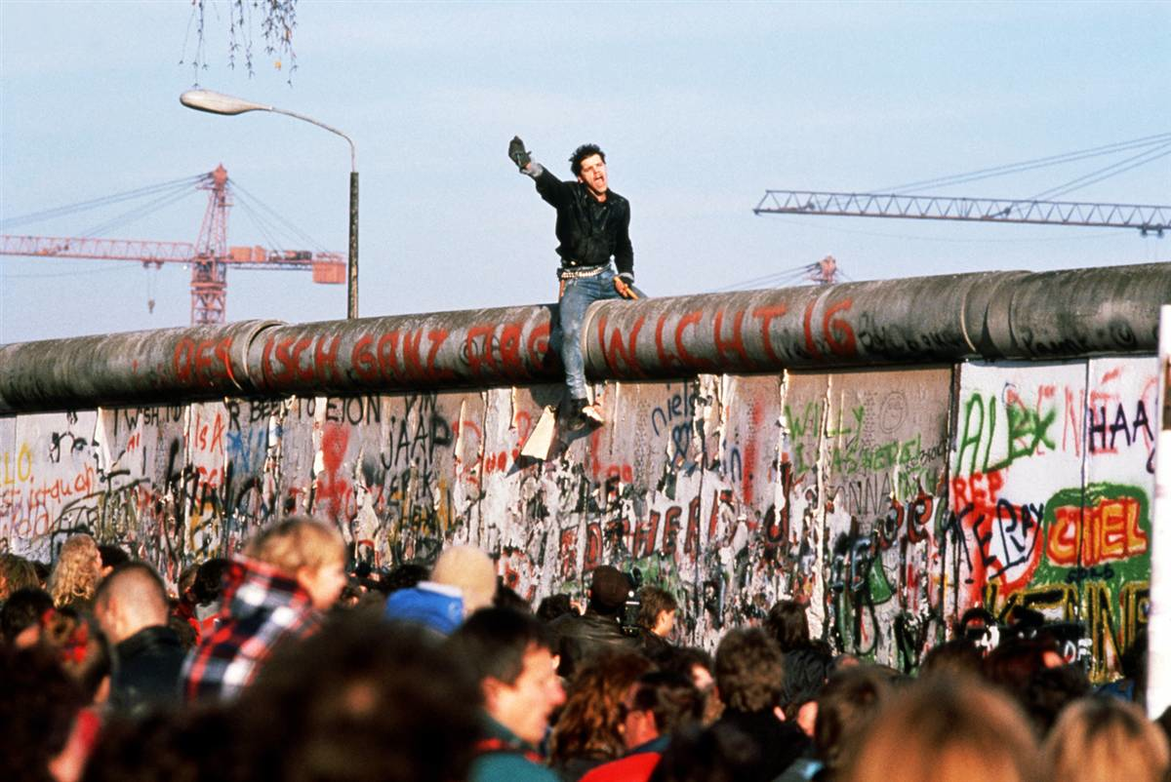

Slide 14
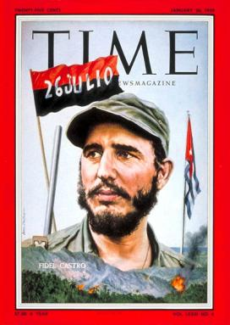
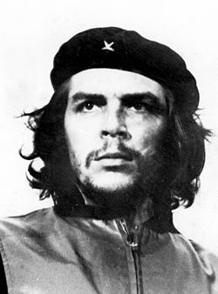
Communism Comes to Latin America
Widespread poverty and repression made Latin America ripe for the spread of Communist beliefs.
In 1959, Fidel Castro overthrew the ruling dictatorship in Cuba.
Castro came to power promising democracy to Cubans, but once in power he nationalized businesses and executed opponents.
The United States reacted to the nationalization of American-owned businesses in Cuba by breaking off trade.
Castro turned to the Soviet Union for support, and transformed Cuba into a Communist state

Slide 15
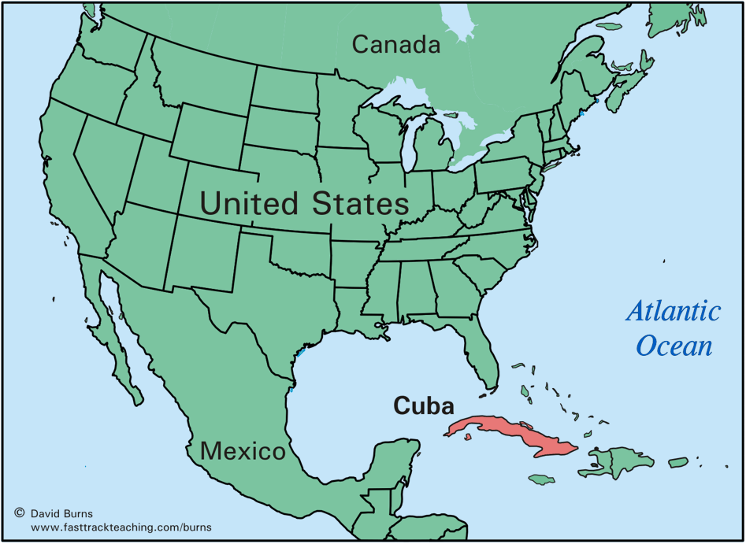
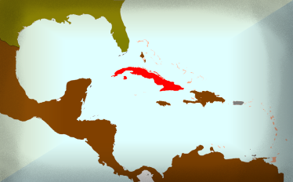

Slide 16
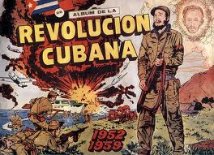
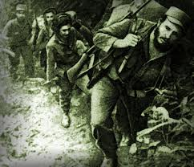
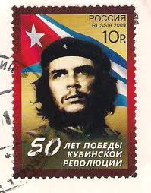

Slide 17
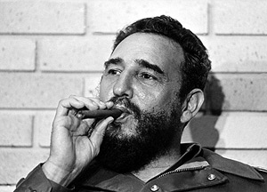
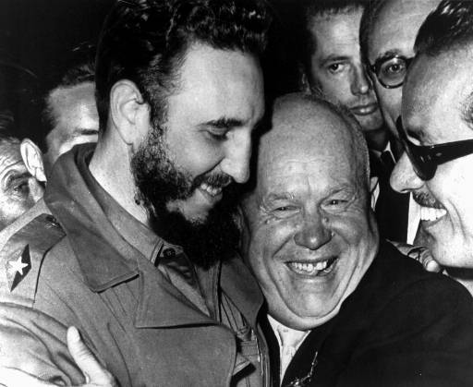

Slide 18
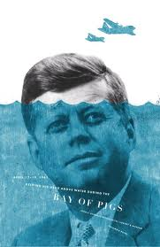
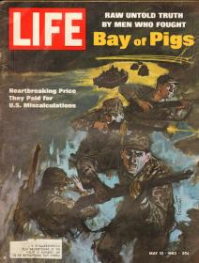
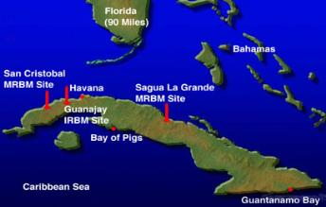
Bay of Pigs
In 1961, Cuban exiles armed and trained by the American Central Intelligence Agency (CIA), invaded Cuba at the Bay of Pigs
President John Kennedy refused to supply the rebels with air support to carry out their attack, and their invasion effort failed.
This was seen as a major embarrassment to the young US president

Slide 19
Cuban Missile Crisis
In 1962, American leaders discovered Cuba was secretly building bases to install Soviet missiles with nuclear warheads.
These would be within striking distance of US cities.
During the “Cuban Missile Crisis,” President Kennedy ordered a naval blockade of Cuba and threatened to invade if the missiles were not withdrawn
The world stood on the brink of nuclear war.
Khrushchev finally agreed to withdraw the missiles for a pledge that the United States would not invade Cuba.
Khrushchev’s failure in the crisis contributed to his removal from power in 1964

Slide 20
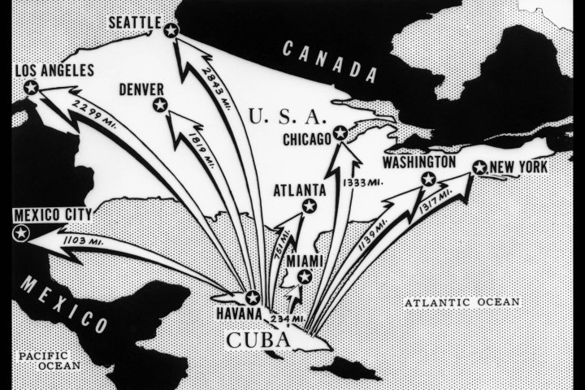

Slide 21
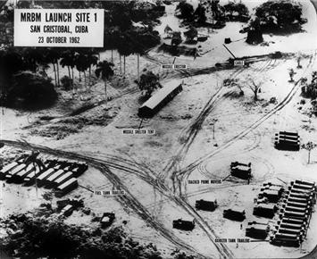
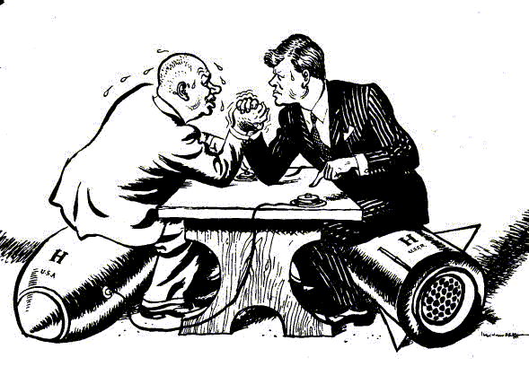

Slide 22
